Slide 1
Safest Ottawa Neighborhoods
Capstone Project - The Battle of Neighborhoods
Abdullahi Mohamed

Slide 2
Business Problem
An apartment rental search website would like to drive more traffic to their website by starting a blog.
One post lists of the safest neighborhoods in Ottawa.
The target audience are people looking to rent an apartment in the safest part of the city.
There has been an increase in crime, so people are worried.

Slide 3
Data
City of Ottawa crime data and Foursquare police station location data will be used to find the safest neighborhoods in the city.
Crime data was imported from a csv file provided by the City of Ottawa. Latitude and longitudes locations were inputted using ‘Nominatim’ from ‘geopy.geocoders’ aswell as manually when the geolocator provided inaccurate location data.
The latitude and longitude data were then combined with the crime data into a single data frame.
Foursquare location data was used to find a data frame of the latitudes and longitudes of police stations in Ottawa.

Slide 4
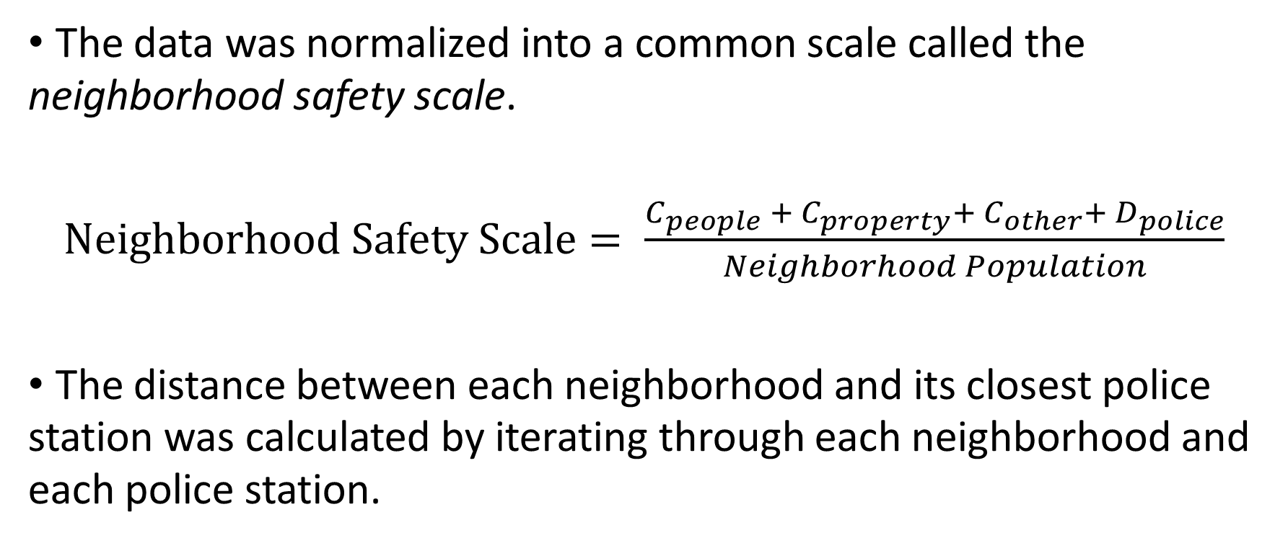
Methodology
The data was normalized into a common scale called the neighborhood safety scale.
$Neighborhood Safety Scale= \frac{C_{people} + C_{property}+ C_{other}+ D_{police}}{Neighborhood Population}$
The distance between each neighborhood and its closest police station was calculated by iterating through each neighborhood and each police station.

Slide 5
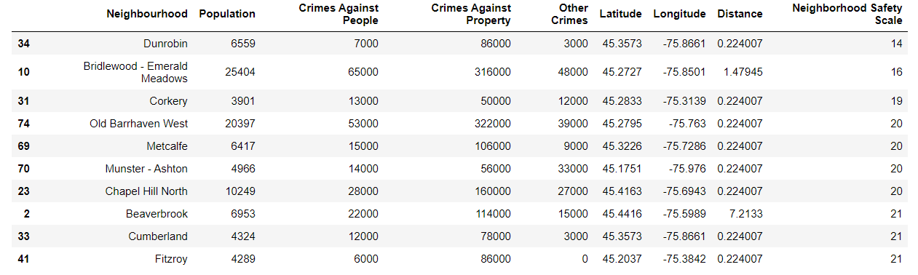
Results

Slide 6
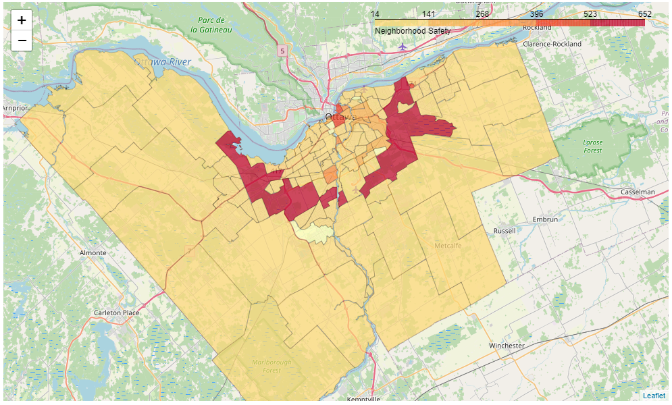
Results

Slide 7
Discussion
Based on the results I recommend looking further into other indicators that may be affecting the safeness of a neighborhood besides proximity to the downtown core.
For instance, household income, unemployment rate, city program funding and other indicators that are known to correlate with crime rate.

Slide 8
Conclusion
The safest neighborhoods in Ottawa were found to be the neighborhoods furthest from the city center.
City crime rates were analyzed for each neighborhood.
The safest neighborhood was found to be Dunrobin the neighborhood on the north-west corner of the city.

